Slide 1
Modera Hospital Records Mgmnt
Introduction
This system has been developed using Java NetBeans 8.0.2 by lordvicus for Medora Health Centre
Why I did choose Java NetBeans for my project
NetBeans is very efficient for me in code development
It is easy to install and easy to use
It is free
It offers great integration with other tools
It connects to MySQL Database.
This system performs/ automates the patient registration and Triage process at the hospital.
In this system patient vitals like Patient ID, Patient Name, Patient Age, Disease the patient is suffering from, Patient Blood Group, Date Admitted are recorded before proceeding for doctor’s appointment.

Slide 2
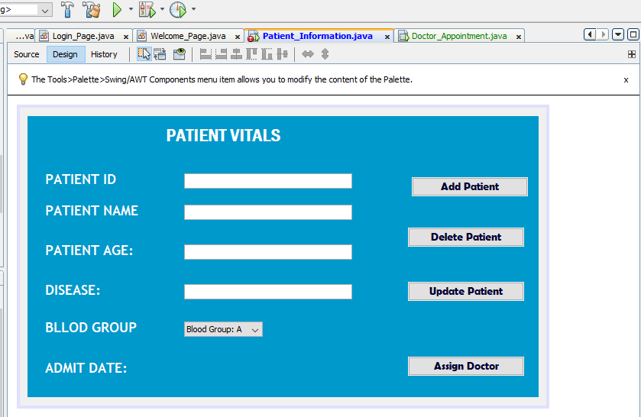
Want big impact?
Use big image.
My System User Design for Patient Vitals
Attached is a Screenshot from my NetBeans IDE for the Patient Vitals

Slide 3
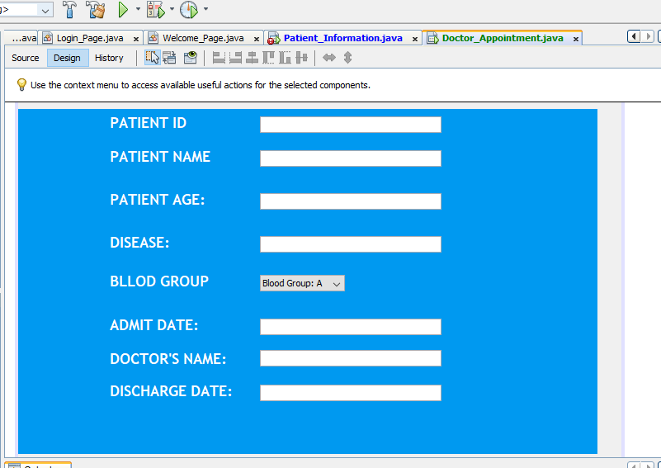
Want big impact?
Use big image.
My System User Design for Patient Vitals
Attached is a Screenshot from my NetBeans IDE for the Doctor Details

Slide 4
Lordvicus Adienge

